Slide 1
Windows form programming

Slide 2
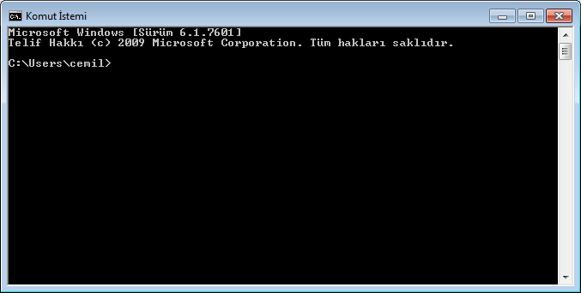

Slide 3
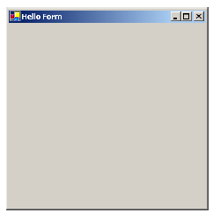

Slide 4
namespace MyNamespace
{
public class MyForm : System.Windows.Forms.Form
{
public MyForm()
{
this.Text = "Hello Form";
}
public static void Main()
{
System.Windows.Forms.Application.Run(new MyForm());
}
}
}

Slide 5
we define a class called MyForm that inherits from the Form class, which is found in the System.Windows.Forms namespace. The period notation is used to separate namespaces and classes, so that the complete, or fully qualified, name for the class is System.Windows.Forms.Form.
namespace MyNamespace
{
public class MyForm : System.Windows.Forms.Form
{
. . .
}
}
The Form class is the cornerstone of Windows-based applications in .NET. It represents
any type of window in an application, from dialog boxes to MDI (Multiple Document Interface) client windows. The Form class provides the ability to display, place controls within, and interact with an application window.

Slide 6
Constructors and methods
Take another look at the declaration of our MyForm class. Note how two members of
this class are defined, namely the MyForm constructor and the Main method. Both members are declared as public, as is the class MyForm.
public class MyForm : System.Windows.Forms.Form
{
public MyForm() // constructor
{
this.Text = "Hello Form";
}
public static void Main()
{
System.Windows.Forms.Application.Run(new MyForm());
}
}

Slide 7
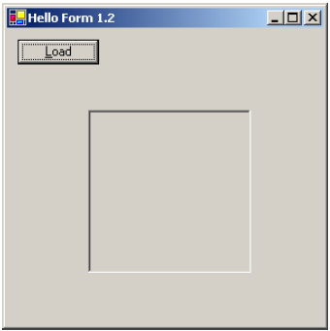
Adding controls
Let’s make our program a little more interesting by adding some controls. Throughout the course of the book, we will be building a photo viewing application, so let’s add a button for loading an image file, and a box where the image can be displayed.
When we are done, our form will look like figure

Slide 8
namespace MyNamespace
{
using System;
using System.Windows.Forms;
public class MyForm : Form
{
private Button btnLoad;
private PictureBox pboxPhoto;
public MyForm()
{
this.Text = "Hello Form 1.2";
// Create and configure the Button
btnLoad = new Button();
btnLoad.Text = "&Load";
btnLoad.Left = 10;
btnLoad.Top = 10;
// Create and configure the PictureBox
pboxPhoto = new PictureBox();
pboxPhoto.BorderStyle =
System.Windows.Forms.BorderStyle.Fixed3D;
pboxPhoto.Width = this.Width / 2;
pboxPhoto.Height = this.Height / 2;
pboxPhoto.Left = (this.Width - pboxPhoto.Width) / 2;
pboxPhoto.Top = (this.Height - pboxPhoto.Height) / 2;

Slide 9
// Add our new controls to the Form
this.Controls.Add(btnLoad);
this.Controls.Add(pboxPhoto);
}
public static void Main()
{
Application.Run(new MyForm());
}
}
}

Slide 10
namespace MyNamespace
{
using System;
using System.Drawing;
using System.Windows.Forms;
public class MyForm : System.Windows.Forms.Form
{
Button btnLoad;
PictureBox pboxPhoto;
public MyForm()
{
this.Text = "Hello Form 1.3";
// Create and configure the Button
btnLoad = new Button();
btnLoad.Text = "&Load";
btnLoad.Left = 10;
btnLoad.Top = 10;
btnLoad.Click += new System.EventHandler(this.OnLoadClick);
// Create and configure the PictureBox
pboxPhoto = new PictureBox();
pboxPhoto.BorderStyle = System.Windows.Forms.BorderStyle.Fixed3D;

Slide 11
pboxPhoto.Width = this.Width / 3;
pboxPhoto.Height = this.Height / 3;
pboxPhoto.Left = (this.Width - pboxPhoto.Width) / 2;
pboxPhoto.Top = (this.Height - pboxPhoto.Height) / 2;
pboxPhoto.SizeMode = PictureBoxSizeMode.StretchImage;
// Add our new controls to the Form
this.Controls.Add(btnLoad);
this.Controls.Add(pboxPhoto);
}
private void OnLoadClick(object sender, System.EventArgs e)
{
OpenFileDialog dlg = new OpenFileDialog();
dlg.Title = "Open Photo";
dlg.Filter = "jpg files (*.jpg)|*.jpg|All files (*.*)|*.*" ;
if (dlg.ShowDialog() == DialogResult.OK)
{
pboxPhoto.Image = new Bitmap(dlg.OpenFile());
}
dlg.Dispose();
}
public static void Main()
{
Application.Run(new MyForm());
}
}
}

Slide 12
event
private void OnLoadClick(object sender, System.EventArgs e)
{
OpenFileDialog dlg = new OpenFileDialog();
dlg.Title = "Open Photo";
dlg.Filter = "jpg files (*.jpg)|*.jpg|All files (*.*)|*.*" ;
if (dlg.ShowDialog() == DialogResult.OK)
{
pboxPhoto.Image = new Bitmap(dlg.OpenFile());
}
dlg.Dispose();
}

Slide 13
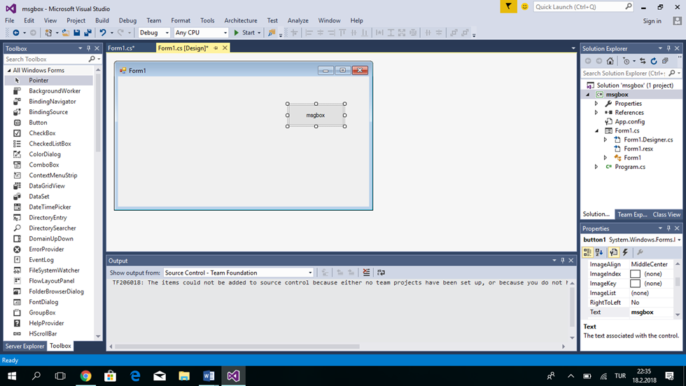

Slide 14
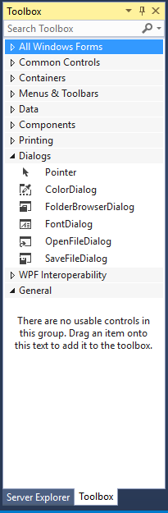
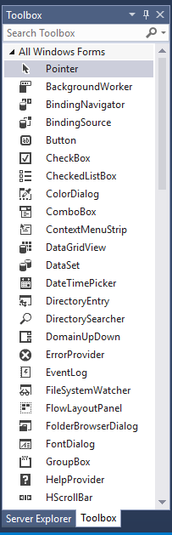
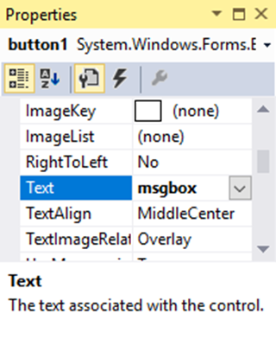
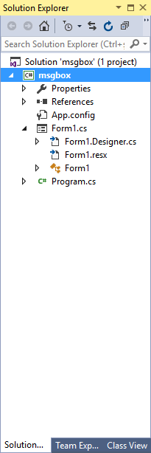

Slide 15
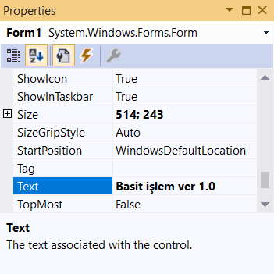
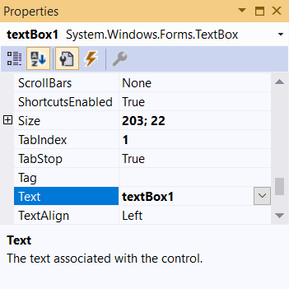
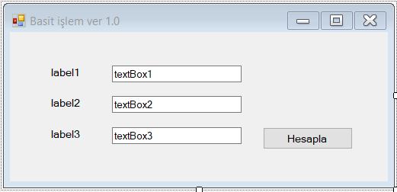
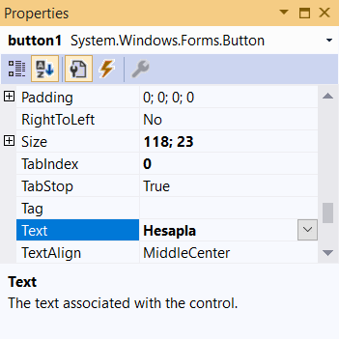
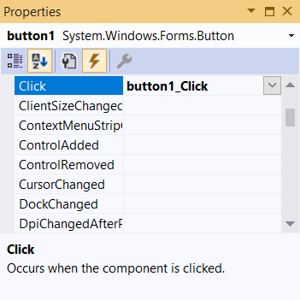
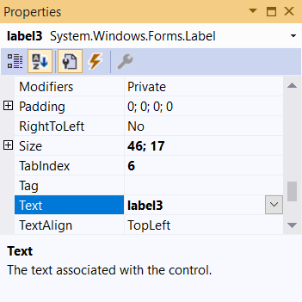

Slide 16
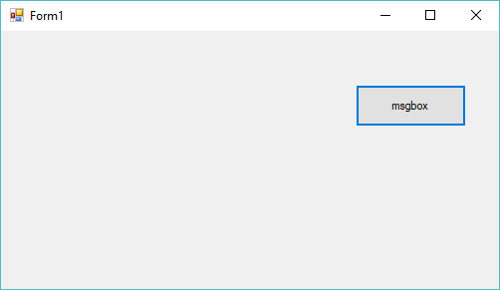
private void button1_Click(object sender, EventArgs e)
{
string msg;
msg = " ali \r";
msg = msg + " mehmet \n";
msg = msg + " ahmet ";
DialogResult sonuc1 = MessageBox.Show(msg, "a sınıf penceresi", MessageBoxButtons.OKCancel, MessageBoxIcon.Question);
if (sonuc1 == DialogResult.OK)
MessageBox.Show(" YOU PRESS THE OK BUTTON");
else
MessageBox.Show(" YOU PRESS THE Cancel BUTTON");
MessageBox.Show("The calculations are complete", "My Application", MessageBoxButtons.OKCancel, MessageBoxIcon.Asterisk);
}

Slide 17
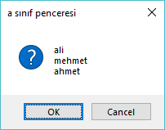
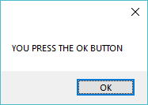
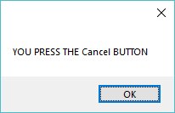
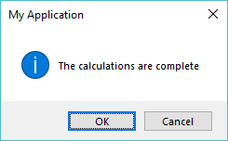
string msg;
msg = " ali \r";
msg = msg + " mehmet \n";
msg = msg + " ahmet ";
DialogResult sonuc1 = MessageBox.Show(msg, "a sınıf penceresi", MessageBoxButtons.OKCancel, MessageBoxIcon.Question);
else
MessageBox.Show(" YOU PRESS THE Cancel BUTTON");
if (sonuc1 == DialogResult.OK)
MessageBox.Show(" YOU PRESS THE OK BUTTON");
MessageBox.Show("The calculations are complete", "My Application", MessageBoxButtons.OKCancel, MessageBoxIcon.Asterisk);

Slide 18
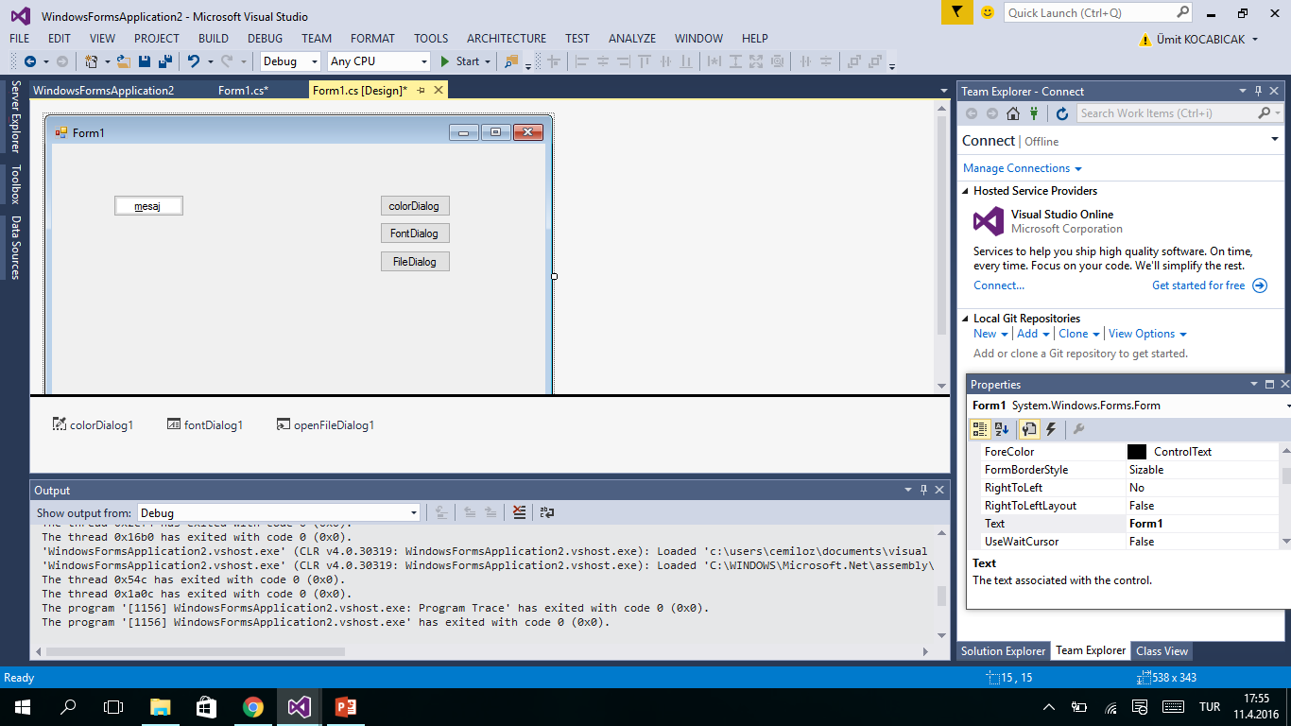
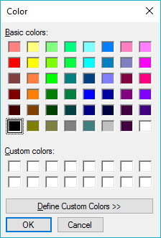
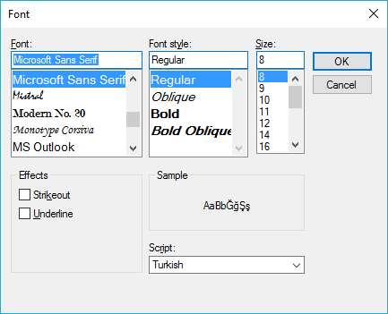
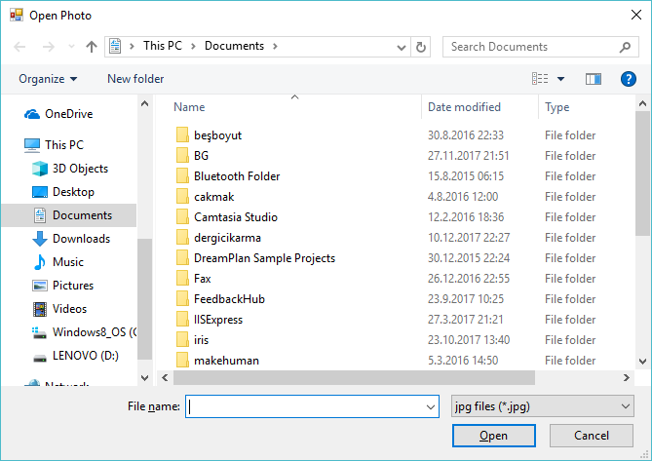

Slide 19
private void button1_Click(object sender, EventArgs e)
{
if (colorDialog1.ShowDialog() == DialogResult.OK)
{
this.BackColor = colorDialog1.Color;
}
}
private void button2_Click(object sender, EventArgs e)
{
if (fontDialog1.ShowDialog() == DialogResult.OK)
{
this.Font = fontDialog1.Font;
}
}
private void button3_Click(object sender, EventArgs e)
{
OpenFileDialog dlg = new OpenFileDialog();
dlg.Title = "Open Photo";
pictureBox1.SizeMode = PictureBoxSizeMode.StretchImage;
dlg.Filter = "jpg files (*.jpg)|*.jpg|All files (*.*)|*.*";
if (dlg.ShowDialog() == DialogResult.OK)
{
pictureBox1.Image = new Bitmap(dlg.OpenFile());
}
dlg.Dispose();
}

Slide 20
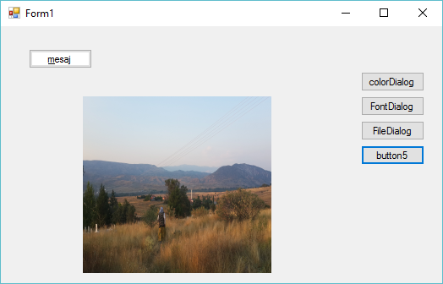

Slide 21
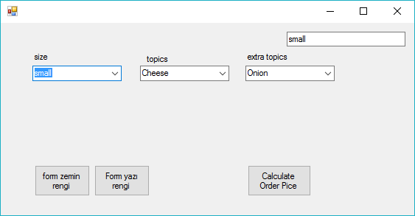
private void Form1_Load(object sender, EventArgs e)
{
label1.Text = "size";
label2.Text = "topics";
label3.Text = "extra topics";
comboBox2.Items.Add("small");
comboBox2.Items.Add("meddium");
comboBox2.Items.Add("large");
comboBox2.SelectedIndex=0;
comboBox3.Items.Add("Cheese");
comboBox3.Items.Add("meat lover");
comboBox3.Items.Add("Greek");
comboBox3.SelectedIndex = 0;
comboBox4.Items.Add("Onion");
comboBox4.Items.Add("beef");
comboBox4.Items.Add("cheese");
comboBox4.SelectedIndex = 0;
}

Slide 22
private void comboBox2_SelectedValueChanged(object sender, EventArgs e)
{
textBox1.Text = comboBox2.Text;
}

Slide 23
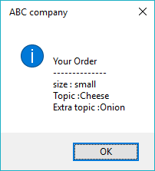
private void button1_Click(object sender, EventArgs e)
{
string msg = "\n Your Order \n --------------";
msg += "\n size : "+comboBox2.Text+"\n Topic :";
msg += comboBox3.Text + "\n Extra topic :";
msg += comboBox4.Text;
MessageBox.Show(msg," ABC company ", MessageBoxButtons.OK,MessageBoxIcon.Information);
}

Slide 24
private void button2_Click(object sender, EventArgs e)
{
ColorDialog cdlg = new ColorDialog();
if (cdlg.ShowDialog() == DialogResult.OK)
{
this.BackColor = cdlg.Color;
}
cdlg.Dispose();
}
private void button3_Click(object sender, EventArgs e)
{
colorDialog1.ShowDialog();
this.ForeColor = colorDialog1.Color;
}

Slide 25
private void button4_Click(object sender, EventArgs e)
{
FontDialog fdlg = new FontDialog();
if (fdlg.ShowDialog() == DialogResult.OK)
{
this.Font = fdlg.Font;
}
fdlg.Dispose();
}

Slide 26
using System;
using System.Collections.Generic;
using System.ComponentModel;
using System.Data;
using System.Drawing;
using System.Linq;
using System.Text;
using System.Threading.Tasks;
using System.Windows.Forms;
namespace form1
{
public partial class Form1 : Form
{
public Form1()
{
InitializeComponent();
}
private void Form1_Load(object sender, EventArgs e)
{
label1.Text = "size";
label2.Text = "topics";
label3.Text = "extra topics";
comboBox2.Items.Add("small");
comboBox2.Items.Add("meddium");
comboBox2.Items.Add("large");
comboBox2.SelectedIndex=0;
comboBox3.Items.Add("Cheese");
comboBox3.Items.Add("meat lover");
comboBox3.Items.Add("Greek");
comboBox3.SelectedIndex = 0;
comboBox4.Items.Add("Onion");
comboBox4.Items.Add("beef");
comboBox4.Items.Add("cheese");
comboBox4.SelectedIndex = 0;
}
private void comboBox2_SelectedValueChanged(object sender, EventArgs e)
{
textBox1.Text = comboBox2.Text;
}
private void button1_Click(object sender, EventArgs e)
{
string msg = "\n Your Order \n --------------";
msg += "\n size : "+comboBox2.Text+"\n Topic :";
msg += comboBox3.Text + "\n Extra topic :";
msg += comboBox4.Text;
MessageBox.Show(msg," ABC company ", MessageBoxButtons.OK,MessageBoxIcon.Information);
}
private void button2_Click(object sender, EventArgs e)
{
ColorDialog cdlg = new ColorDialog();
if (cdlg.ShowDialog() == DialogResult.OK)
{
this.BackColor = cdlg.Color;
}
cdlg.Dispose();
}
private void button3_Click(object sender, EventArgs e)
{
colorDialog1.ShowDialog();
this.ForeColor = colorDialog1.Color;
}
}
}

Slide 27
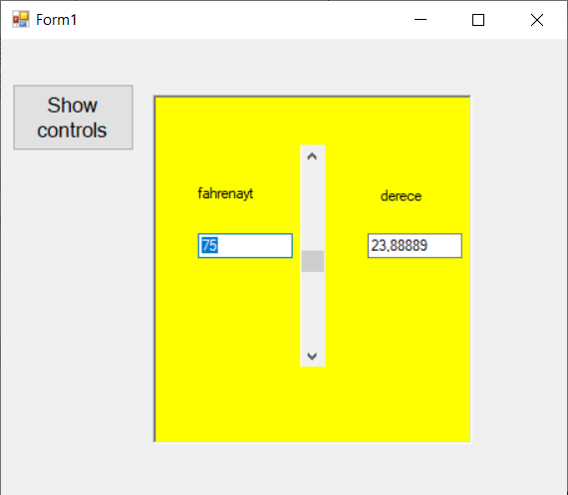
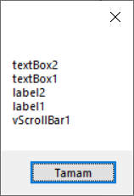
private void vScrollBar1_Scroll(object sender, ScrollEventArgs e)
{ int f;
Single c;
f = vScrollBar1.Value;
c = ((Single)5 / (Single)9) * ((System.Convert.ToSingle(f) - (Single)32));
textBox1.Text = System.Convert.ToString(f);
textBox2.Text = System.Convert.ToString(c);
if (f < 32)
{
panel1.BackColor = Color.Blue;
}
if (f >= 32 && f < 60)
{
panel1.BackColor = Color.Green;
}
if (f >= 60 && f < 80)
{
panel1.BackColor = Color.Yellow;
}
if (f >= 80)
{
panel1.BackColor = Color.Red;
}
}
private void button1_Click(object sender, EventArgs e)
{
string msg = "";
foreach (Control s in panel1.Controls)
{
msg += Convert.ToString(s.Name) + "\n";
}
MessageBox.Show(msg);
}
BorderStyle

Slide 28
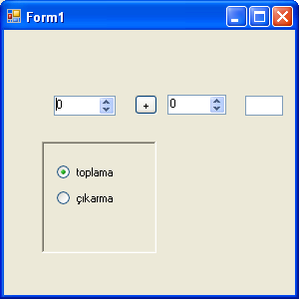

Slide 29
public partial class Form1 : Form
{
int a, b;
Single c;
public Form1()
private void radioButton1_CheckedChanged(object sender, EventArgs e)
{
textBox1.Text = " ";
button1.Text = "+";
}
private void radioButton2_CheckedChanged(object sender, EventArgs e)
{
textBox1.Text = " ";
button1.Text = "-";
}

Slide 30
private void numericUpDown1_ValueChanged(object sender, EventArgs e)
{
if (button1.Text == "+")
{
c = System.Convert.ToSingle(numericUpDown1.Value) + System.Convert.ToSingle(numericUpDown2.Value);
textBox1.Text = System.Convert.ToString(c);
}
if (button1.Text == "-")
{
c = System.Convert.ToSingle(numericUpDown1.Value) - System.Convert.ToSingle(numericUpDown2.Value);
textBox1.Text = System.Convert.ToString(c);
}
}

Slide 31
private void numericUpDown2_ValueChanged(object sender, EventArgs e)
{
if (button1.Text == "+")
{
c = System.Convert.ToSingle(numericUpDown1.Value) + System.Convert.ToSingle(numericUpDown2.Value);
textBox1.Text = System.Convert.ToString(c);
}
if (button1.Text == "-")
{
c = System.Convert.ToSingle(numericUpDown1.Value) - System.Convert.ToSingle(numericUpDown2.Value);
textBox1.Text = System.Convert.ToString(c);
}

Slide 32
using System;
using System.Windows.Forms;
namespace WindowsFormsApplication1
{
public partial class Form1 : Form
{
public Form1()
{
InitializeComponent();
}
private void Form1_Load(object sender, EventArgs e)
{
// Show the color dialog.
DialogResult result = colorDialog1.ShowDialog();
// See if user pressed ok.
if (result == DialogResult.OK)
{
// Set form background to the selected color.
this.BackColor = colorDialog1.Color;
}
}
}
}

Slide 33
using System;
using System.Drawing;
using System.Windows.Forms;
namespace WindowsFormsApplication1
{
public partial class Form1 : Form
{
public Form1()
{
InitializeComponent();
}
private void button1_Click(object sender, EventArgs e)
{
// Show the dialog.
DialogResult result = fontDialog1.ShowDialog();
// See if OK was pressed.
if (result == DialogResult.OK)
{
// Get Font.
Font font = fontDialog1.Font;
// Set TextBox properties.
this.textBox1.Text = string.Format("Font: {0}", font.Name);
this.textBox1.Font = font;
}
}
}
}

Slide 34
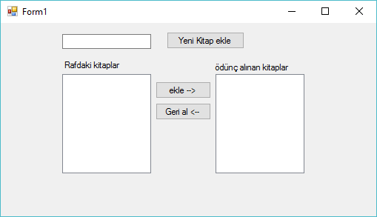
private void button1_Click(object sender, EventArgs e)
{
listBox1.Items.Add(textBox1.Text);
textBox1.Text = "";
textBox1.Focus();
}

Slide 35
private void button2_Click(object sender, EventArgs e)
{
listBox2.Items.Add(listBox1.SelectedItem);
listBox1.Items.Remove(listBox1.SelectedItem);
}

Slide 36
private void button3_Click(object sender, EventArgs e)
{
listBox1.Items.Add(listBox2.SelectedItem);
listBox2.Items.Remove(listBox2.SelectedItem);
}

Slide 37
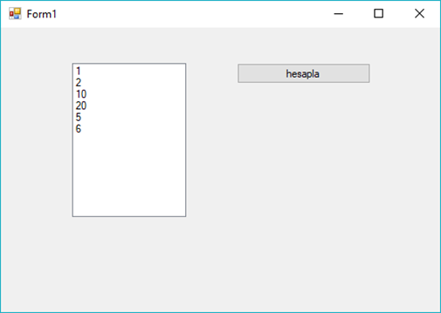
using System;
using System.Windows.Forms;
namespace WindowsFormsApp1
{
public partial class Form1 : Form
{
public Form1()
{
InitializeComponent();
}
private void Form1_Load(object sender, EventArgs e)
{
listBox1.Items.Add("1");
listBox1.Items.Add("2");
listBox1.Items.Add("10");
listBox1.Items.Add("20");
listBox1.Items.Add("5");
listBox1.Items.Add("6");
}
private void button1_Click(object sender, EventArgs e)
{
Single result = 0;
foreach(string s in listBox1.Items)
{
result += Convert.ToSingle(s);
}
button1.Text ="sonuc="+ result.ToString();
}
}
}

Slide 38
using System;
using System.Windows.Forms;
namespace WindowsFormsApp1
{
public partial class Form1 : Form
{
public Form1()
{
InitializeComponent();
}
private void Form1_Load(object sender, EventArgs e)
{
Random rastgele = new Random();
for (int i = 0; i < 10; i++)
{
Convert.ToString(rastgele.Next(100));
listBox1.Items.Add(Convert.ToString(rastgele.Next(100)));
}
}
private void button1_Click(object sender, EventArgs e)
{
Single result = 0;
foreach(string s in listBox1.Items)
{
result += Convert.ToSingle(s);
}
button1.Text ="sonuc="+ result.ToString();
}
}
}

Slide 39
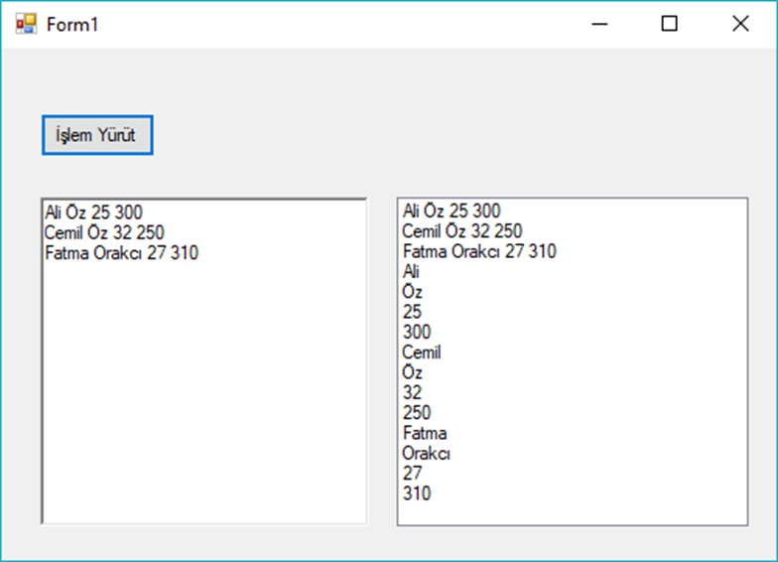
using System;
using System.Collections.Generic;
using System.ComponentModel;
using System.Data;
using System.Drawing;
using System.Linq;
using System.Text;
using System.Threading.Tasks;
using System.Windows.Forms;
namespace WindowsFormsApp2
{
public partial class Form1 : Form
{
public Form1()
{
InitializeComponent();
}
private void Form1_Load(object sender, EventArgs e)
{
richTextBox1.Text = "Ali Öz 25 300\nCemil Öz 32 250\nFatma Orakcı 27 310";
}
private void button1_Click(object sender, EventArgs e)
{
string hepsi = richTextBox1.Text;
string[] satirlar=hepsi.Split('\n');
foreach(string s in satirlar)
{
listBox1.Items.Add(s);
}
foreach (string s in satirlar)
{
string[] kelimeler= s.Split(' ');
foreach (string k in kelimeler)
{
listBox1.Items.Add(k);
}
}
}
}
}

Slide 40
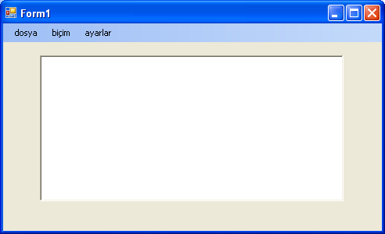
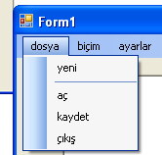
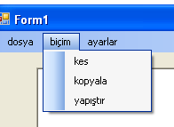
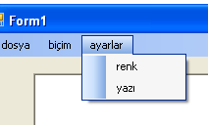
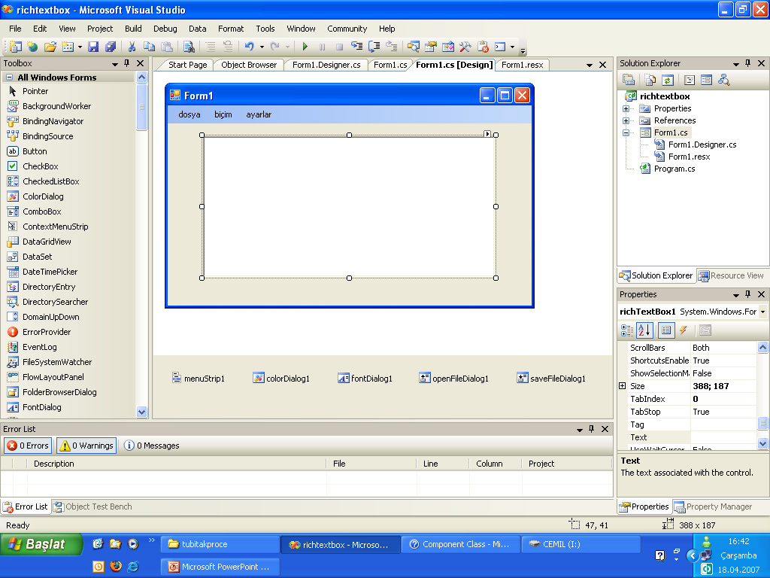

Slide 41
private void yeniToolStripMenuItem_Click(object sender, EventArgs e)
{
richTextBox1.Text = " ";
}
private void açToolStripMenuItem_Click(object sender, EventArgs e)
{
if ( openFileDialog1.ShowDialog() == DialogResult.OK)
{
richTextBox1.LoadFile(openFileDialog1.FileName);
}
}
private void kaydetToolStripMenuItem_Click(object sender, EventArgs e)
{
if ( saveFileDialog1.ShowDialog() == DialogResult.OK)
{
richTextBox1.SaveFile(saveFileDialog1.FileName, RichTextBoxStreamType.RichText);
}
}

Slide 42
private void çıkışToolStripMenuItem_Click(object sender, EventArgs e)
{
Close();
}
private void kesToolStripMenuItem_Click(object sender, EventArgs e)
{
richTextBox1.Cut();
}
private void kopyalaToolStripMenuItem_Click(object sender, EventArgs e)
{
richTextBox1.Copy();
}
private void yapıştırToolStripMenuItem_Click(object sender, EventArgs e)
{
richTextBox1.Paste();
}

Slide 43
private void renkToolStripMenuItem_Click(object sender, EventArgs e)
{
colorDialog1.ShowDialog();
richTextBox1.ForeColor = colorDialog1.Color;
}
private void yazıToolStripMenuItem_Click(object sender, EventArgs e)
{
if (fontDialog1.ShowDialog() == DialogResult.OK)
{
richTextBox1.Font = fontDialog1.Font;
}
}
private void yazıToolStripMenuItem_Click(object sender, EventArgs e)
{
fontDialog1.ShowDialog();
richTextBox1.Font = fontDialog1.Font;
}

Slide 44
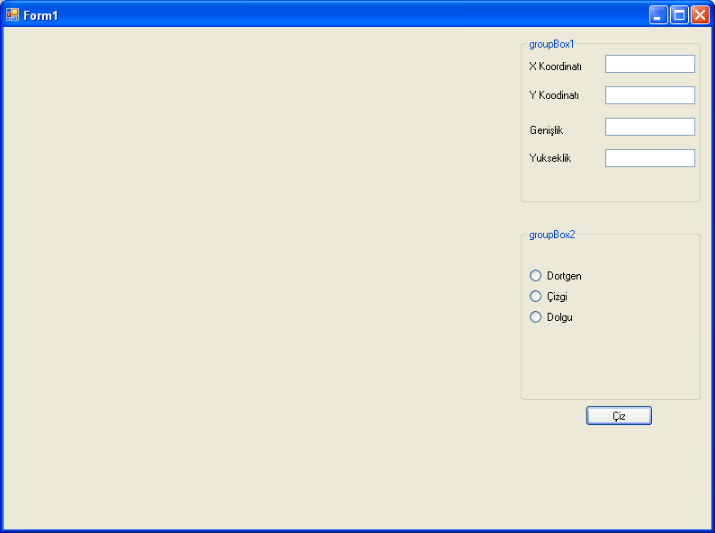

Slide 45
private void button1_Click(object sender, EventArgs e)
{
Graphics cizim;
cizim = this.CreateGraphics();
Pen kalem = new Pen(Color.Green, 2);
SolidBrush firca=new SolidBrush(Color.Red);
if (rbdRec.Checked==true)
cizim.DrawRectangle (kalem, Convert.ToInt32(txtXK.Text), Convert.ToInt32(txtYK.Text),
Convert.ToInt32(txtG.Text), Convert.ToInt32(txtY.Text));
if (rbdLine.Checked == true)
cizim.DrawLine(kalem, Convert.ToInt32(txtXK.Text), Convert.ToInt32(txtYK.Text),
Convert.ToInt32(txtG.Text), Convert.ToInt32(txtY.Text));
if (rbddolu.Checked == true)
cizim.FillRectangle (firca, Convert.ToInt32(txtXK.Text), Convert.ToInt32(txtYK.Text),
Convert.ToInt32(txtG.Text), Convert.ToInt32(txtY.Text));
}

Slide 46
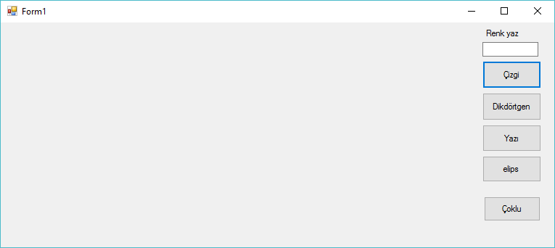

Slide 47
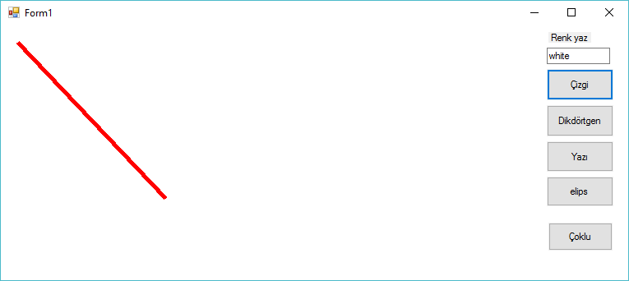
private void button1_Click(object sender, EventArgs e)
{
System.Drawing.Graphics graphicsObj;
graphicsObj = this.CreateGraphics();
Color a = Color.FromName(textBox1.Text);
graphicsObj.Clear(a);
Pen myPen = new Pen(System.Drawing.Color.Red, 5);
graphicsObj.DrawLine(myPen, 20, 20, 200, 210);
}

Slide 48
private void button2_Click(object sender, EventArgs e)
{
System.Drawing.Graphics graphicsObj;
graphicsObj = this.CreateGraphics();
Pen myPen = new Pen(System.Drawing.Color.Red, 5);
Rectangle myRectangle = new Rectangle(20, 20, 250, 200);
graphicsObj.DrawRectangle(myPen, myRectangle);
}
private void button3_Click(object sender, EventArgs e)
{
System.Drawing.Graphics graphicsObj;
graphicsObj = this.CreateGraphics();
Font myFont = new System.Drawing.Font("Helvetica", 40, FontStyle.Italic);
Brush myBrush = new SolidBrush(System.Drawing.Color.Red);
graphicsObj.DrawString("Hello C#", myFont, myBrush, 30, 30);
}
private void button4_Click(object sender, EventArgs e)
{
System.Drawing.Graphics graphicsObj;
graphicsObj = this.CreateGraphics();
Pen myPen = new Pen(System.Drawing.Color.Green, 5);
Rectangle myRectangle = new Rectangle(20, 20, 250, 200);
graphicsObj.DrawEllipse(myPen, myRectangle);
}

Slide 49
private void button5_Click(object sender, EventArgs e)
{
// render list contains all shapes
List<Rectangle> DrawList = new List<Rectangle>();
// add example data
DrawList.Add(new Rectangle(10, 30, 10, 40));
DrawList.Add(new Rectangle(50, 40, 20, 10));
DrawList.Add(new Rectangle(20, 20, 30, 20));
// draw
Graphics g = this.CreateGraphics();
foreach (Rectangle Object in DrawList)
{
g.FillRectangle(new SolidBrush(Color.Black), Object);
}
}

Slide 50
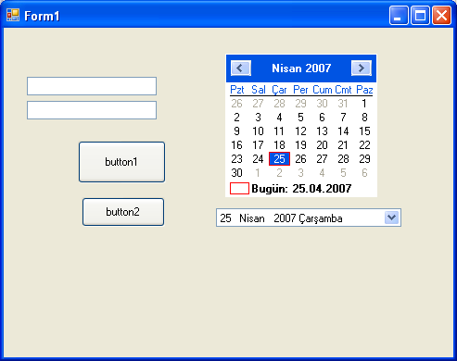

Slide 51
private void button1_Click(object sender, EventArgs e)
{
monthCalendar1.BackColor = Color.Red;
monthCalendar1.ForeColor = Color.Green;
textBox1.Text = System.Convert.ToString( monthCalendar1.TodayDate);
}
private void button2_Click(object sender, EventArgs e)
{
this.dateTimePicker1.CustomFormat = "HH-mm-ss : MMMM/dd/yyyy tt";
this.dateTimePicker1.Format = System.Windows.Forms.DateTimePickerFormat.Custom;
this.dateTimePicker1.Location = new System.Drawing.Point(200, 200);
this.dateTimePicker1.Name = "dateTimePicker";
this.dateTimePicker1.Size = new System.Drawing.Size(240, 20);
this.dateTimePicker1.TabIndex = 0;
dateTimePicker1.CalendarForeColor = Color.Red;
dateTimePicker1.CustomFormat = " MMMM/dddd/yy";
}

Slide 52
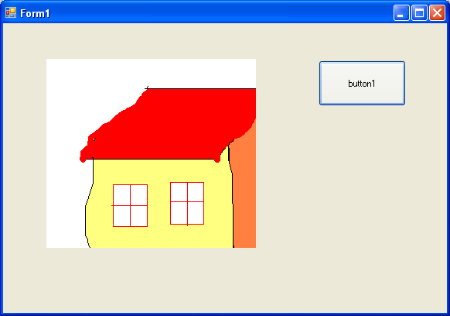

Slide 53
private void button1_Click(object sender, EventArgs e)
{
OpenFileDialog open = new OpenFileDialog();
open.Filter = "Image Files(*.jpg; *.jpeg; *.gif; *.bmp)|*.jpg; *.jpeg; *.gif; *.bmp";
if (open.ShowDialog() == DialogResult.OK)
{
pictureBox1.Image = new Bitmap(open.FileName);
}
}

Slide 54
private void button2_Click(object sender, EventArgs e)
{
pictureBox1.SizeMode = System.Windows.Forms.PictureBoxSizeMode.StretchImage;
}
private void button3_Click(object sender, EventArgs e)
{
pictureBox1.SizeMode = System.Windows.Forms.PictureBoxSizeMode.AutoSize;
}
private void button4_Click(object sender, EventArgs e)
{
pictureBox1.SizeMode = System.Windows.Forms.PictureBoxSizeMode.CenterImage;
}

Slide 55
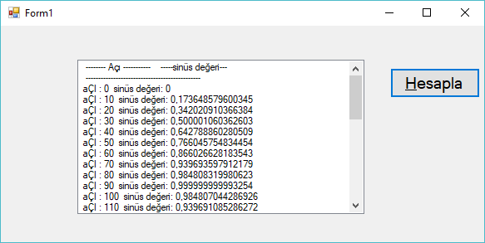
private void button1_Click(object sender, EventArgs e)
{
int aci;
double sin_deg,radyan;
listBox1.Items.Add(" ---- Açı -- -----sinüs değeri---") ;
listBox1.Items.Add(" -----------------------------------");
for (aci = 0; aci <= 360; aci++)
{
radyan=System.Convert.ToDouble (aci) * 3.1416 / 180.00;
sin_deg = Math.Sin(radyan );
listBox1.Items.Add(" aÇI : " + System.Convert.ToString(aci) + " sinüs değeri: " + System.Convert.ToString(sin_deg));
}
}

Slide 56
private void radioButton1_CheckedChanged(object sender, EventArgs e)
{
if (colorDialog1.ShowDialog() == DialogResult.OK)
{
button1.ForeColor = colorDialog1.Color;
}
}
private void radioButton2_CheckedChanged(object sender, EventArgs e)
{
if (colorDialog1.ShowDialog() == DialogResult.OK)
{
button1.BackColor = colorDialog1.Color;
}
}

Slide 57
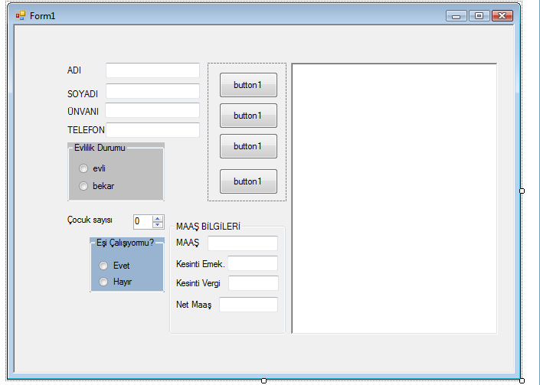

Slide 58
public partial class Form1 : Form
{
Single maas, kesinti, emekli, netmaas;
public Form1()
{
InitializeComponent();
}
private void radioButton2_CheckedChanged(object sender, EventArgs e)
{
groupBox2.Enabled = false;
hesapla();
}
private void radioButton1_CheckedChanged(object sender, EventArgs e)
{
groupBox2.Enabled = true ;
hesapla();
}

Slide 59
string msg1,msg;
int a, b;
msg = textBox1.Text;
b = msg.Length;
msg1 = msg.Substring(0, b);
for (a = b ; a <= 10; a++)
{
msg1 = msg1 + "_";
}
richTextBox1.Text = msg1;
msg = textBox2.Text;
b = msg.Length;
msg1 = msg.Substring(0, b);
for (a = b; a <= 10; a++)
{
msg1 = msg1 + "_";
}
richTextBox1.Text =richTextBox1 .Text + msg1;
msg = textBox3.Text;
b = msg.Length;
msg1 = msg.Substring(0, b);
for (a = b; a <= 10; a++)
{
msg1 = msg1 + "_";
}
richTextBox1.Text = richTextBox1 .Text + msg1;

Slide 60
private void textBox5_TextChanged(object sender, EventArgs e)
{
maas = System.Convert.ToSingle (textBox5.Text);
kesinti = maas * (Single )0.10;
emekli = maas * (Single)0.20;
netmaas = maas - kesinti - emekli;
textBox6.Text = System.Convert.ToString(emekli);
textBox7.Text = System.Convert.ToString(kesinti);
textBox8.Text = System.Convert.ToString(netmaas);
}

Slide 61
private void hesapla()
{
maas = System.Convert.ToSingle(0);
if (radioButton1.Checked)
{
if (radioButton4.Checked)
maas = System.Convert.ToSingle(800);
}
if (radioButton1.Checked)
{
if (radioButton3.Checked)
maas = System.Convert.ToSingle(700);
}
if (radioButton2.Checked)
{
maas = System.Convert.ToSingle(700);
}
if(numericUpDown1.Value==1)
maas = maas + System.Convert.ToSingle(30);
if (numericUpDown1.Value > 1)
maas = maas + System.Convert.ToSingle(60);
textBox5.Text = System.Convert.ToString(maas);
}

Slide 62
private void numericUpDown1_ValueChanged(object sender, EventArgs e)
{
hesapla();
}
private void radioButton3_CheckedChanged(object sender, EventArgs e)
{
hesapla();
}
private void radioButton4_CheckedChanged(object sender, EventArgs e)
{
hesapla();
}

Slide 63
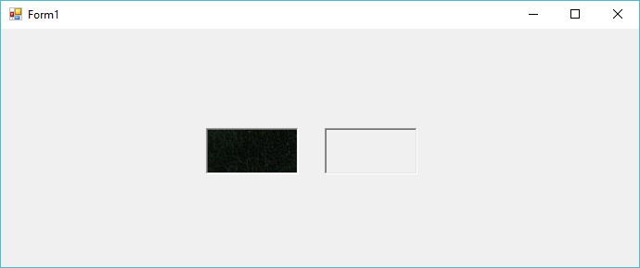
using System;
using System.Windows.Forms;
namespace cemilpicturebox
{
public partial class Form1 : Form
{
public Form1()
{
InitializeComponent();
}
private void pictureBox1_MouseEnter(object sender, EventArgs e)
{
pictureBox1.Height += 10;
pictureBox1.Width += 10;
}
private void pictureBox1_MouseLeave(object sender, EventArgs e)
{
pictureBox1.Height -= 10;
pictureBox1.Width -= 10;
}
private void pictureBox2_MouseEnter(object sender, EventArgs e)
{
pictureBox2.Height += 10;
pictureBox2.Width += 10;
}
private void pictureBox2_MouseLeave(object sender, EventArgs e)
{
pictureBox2.Height -= 10;
pictureBox2.Width -= 10;
}
}
}

Slide 64
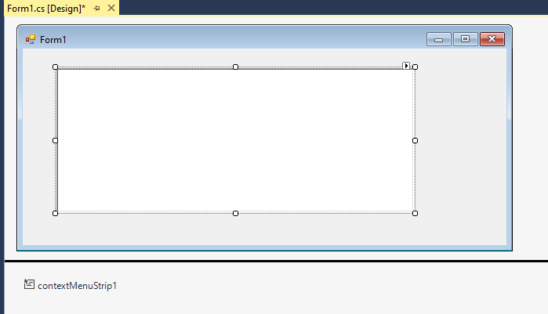
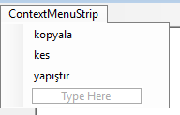
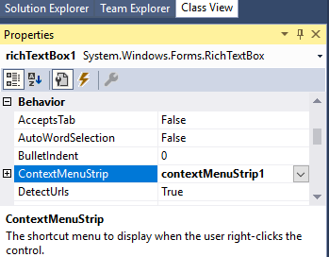
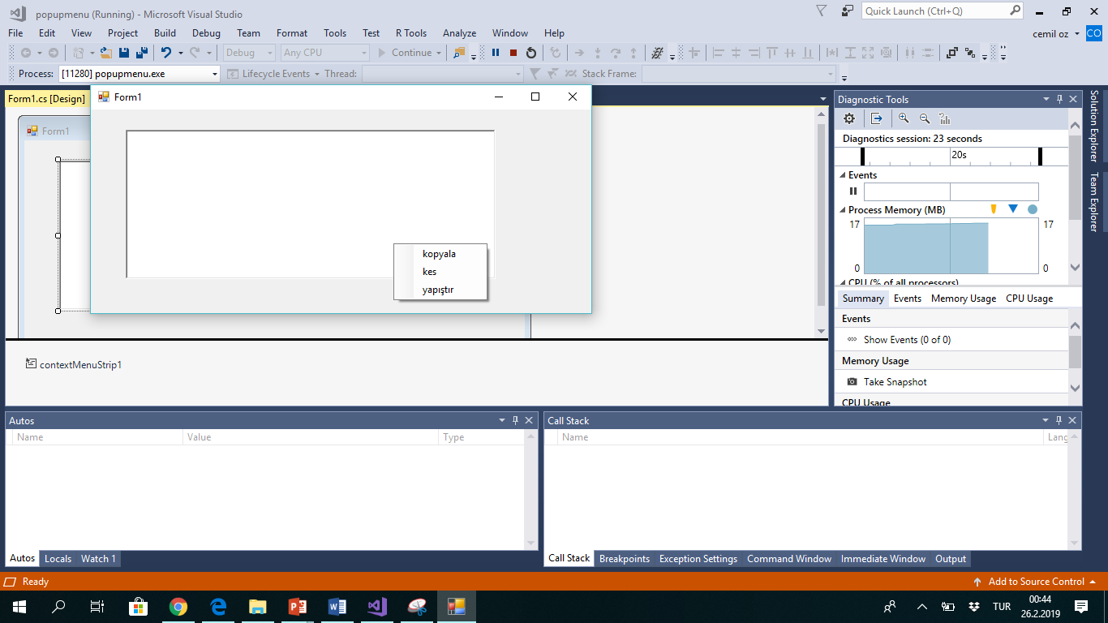

Slide 65
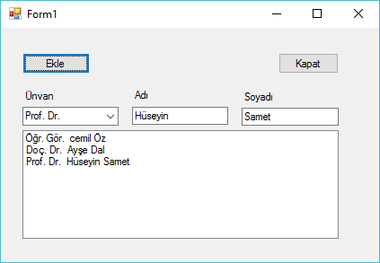
private void Form1_Load(object sender, EventArgs e)
{
comboBox1.Items.Add("Uzman ");
comboBox1.Items.Add("Arş. Gör. ");
comboBox1.Items.Add("Öğr. Gör. ");
comboBox1.Items.Add("Yrd. Doç. Dr. ");
comboBox1.Items.Add("Doç. Dr. ");
comboBox1.Items.Add("Prof. Dr. ");
}

Slide 66
private void button2_Click(object sender, EventArgs e)
{
string unvan = comboBox1.Text;
string adi = textBox1.Text;
string soyAdi = textBox2.Text;
listBox1.BeginUpdate();
listBox1.Items.Add(unvan + " " + adi + " " + soyAdi);
listBox1.EndUpdate();
}

Slide 67

using System;
using System.Text;
namespace renk
{
class Program
{
static void Main(string[] args)
{
Console.WriteLine("\t normal renk. ");
Console.BackgroundColor = ConsoleColor.Red;
Console.ForegroundColor = ConsoleColor.White;
Console.WriteLine("\t beyaz üzerine kırmızı.");
// beya üzerine kırmızı devam edecektir
Console.WriteLine("\t değiştirilmedikçe aynı.");
// normal renk'e dönüş
Console.ResetColor();
Console.WriteLine("\t Console.ResetColor() ve normal renk. ");
Console.ReadKey();
}
}
}

Slide 68

using System;
using System.Text;
namespace renk
{
class Program
{
static void Main(string[] args)
{
//
Console.BackgroundColor = ConsoleColor.Black;
Console.ForegroundColor = ConsoleColor.White;
Console.WriteLine(" siyah üzeri beyaz ");
Console.WriteLine();
if (Console.BackgroundColor == ConsoleColor.Black)
{
Console.BackgroundColor = ConsoleColor.Red;
Console.ForegroundColor = ConsoleColor.White;
Console.WriteLine(" Kırmızı üzeri siyah ");
}
Console.ReadKey();
}
}
}

Slide 69

using System;
using System.Text;
namespace renk
{
class Program
{
static void Main(string[] args)
{
// yeşil(green) satır.
//
Yazdir(" Bu satır yeşil üzeri siyah .");
Console.WriteLine();
// bir defa daha metodu çağır
Yazdir(" Bu satırda aynı şekilde yeşil üzeri siyah");
Console.WriteLine();
Console.ReadKey();
}
static void Yazdir(string value)
{
// Yeşil zemin üzerine siyah yazı
Console.BackgroundColor = ConsoleColor.Green;
Console.ForegroundColor = ConsoleColor.DarkGreen;
Console.WriteLine(value.PadRight(Console.WindowWidth - 1));
// renk sıfırlanmakta
Console.ResetColor();
}
}
}

Slide 70

using System;
using System.Text;
namespace renk
{
class Program
{
static void Main(string[] args)
{
//
// zemin ve yazı için renk örnekği
//
Type tip = typeof(ConsoleColor);
Console.ForegroundColor = ConsoleColor.White;// yazı beyaz
foreach (var renkAdi in Enum.GetNames(tip))
{
Console.BackgroundColor = (ConsoleColor)Enum.Parse(tip, renkAdi);
Console.WriteLine("\t" + renkAdi);
}
Console.BackgroundColor = ConsoleColor.Black; // zemin siyah
foreach (var renkAdi in Enum.GetNames(tip))
{
Console.ForegroundColor = (ConsoleColor)Enum.Parse(tip, renkAdi);
Console.WriteLine("\t\t"+ renkAdi);
}
Console.ReadKey();
}
}
}

Slide 71
using System;
using System.Collections.Generic;
using System.ComponentModel;
using System.Data;
using System.Drawing;
using System.Linq;
using System.Text;
using System.Threading.Tasks;
using System.Windows.Forms;
namespace cizimwithfare
{
public partial class Form1 : Form
{
System.Drawing.Graphics formGraphics;
bool isDown = false;
int initialX;
int initialY;
int width, height;
Pen drwaPen = new Pen(Color.Navy, 1);
List<Rectangle> cizim = new List<Rectangle>() ;
public Form1()
{
InitializeComponent();
}
private void Form1_MouseDown(object sender, MouseEventArgs e)
{
isDown = true;
initialX = e.X;
initialY = e.Y;
}
private void Form1_MouseUp(object sender, MouseEventArgs e)
{
isDown = false;
cizim.Add(new Rectangle(initialX, initialY, width * Math.Sign(width), height * Math.Sign(height)));
formGraphics = this.CreateGraphics();
foreach(Rectangle r in cizim)
{
formGraphics.DrawRectangle(drwaPen,r);
}
}
private void Form1_MouseMove(object sender, MouseEventArgs e)
{
if (isDown == true)
{
this.Refresh();
width = e.X - initialX;
height = e.Y - initialY;
//if (Math.Sign (width) == -1) width = width
//Rectangle rect = new Rectangle(initialPt.X, initialPt.Y, Cursor.Position.X - initialPt.X, Cursor.Position.Y - initialPt.Y);
Rectangle rect = new Rectangle(initialX, initialY, width * Math.Sign(width), height * Math.Sign(height));
formGraphics = this.CreateGraphics();
formGraphics.DrawRectangle(drwaPen, rect);
//formGraphics.DrawPie(drwaPen, rect, 0.0F,45.0F);
}
}
}
}

Slide 72
private void Form1_MouseUp_1(object sender, MouseEventArgs e)
{
textBox1.Text = "1";
//cizim.Add(new Rectangle(initialX, initialY, width * Math.Sign(width), height * Math.Sign(height)));
_releasedLocationX = e.X;
_releasedLocationY = e.Y;
textBox1.Text = "2";
graphics = this.CreateGraphics();
SolidBrush solidbrush = new SolidBrush(Color.Magenta);
Pen pen = new Pen(Color.DarkRed, 2);
graphics.Clear(Color.Azure);
switch (comboBox1.SelectedItem.ToString())
{
case "Filled Square":
graphics.FillRectangle(solidbrush,
Math.Min(_pressedLocationX, _releasedLocationX), // Left
Math.Min(_pressedLocationY, _releasedLocationY), // Top
Math.Abs(_releasedLocationX - _pressedLocationX), // Width
Math.Abs(_releasedLocationY - _pressedLocationY)); // Height
break;
case "Filled Circle":
graphics.FillEllipse(solidbrush,
Math.Min(_pressedLocationX, _releasedLocationX), // Left
Math.Min(_pressedLocationY, _releasedLocationY), // Top
Math.Abs(_releasedLocationX - _pressedLocationX), // Width
Math.Abs(_releasedLocationY - _pressedLocationY)); // Height
break;
case "Line Square":
graphics.DrawRectangle(pen,
Math.Min(_pressedLocationX, _releasedLocationX), // Left
Math.Min(_pressedLocationY, _releasedLocationY), // Top
Math.Abs(_releasedLocationX - _pressedLocationX), // Width
Math.Abs(_releasedLocationY - _pressedLocationY)); // Height
break;
case "Line Circle":
graphics.DrawEllipse(pen,
Math.Min(_pressedLocationX, _releasedLocationX), // Left
Math.Min(_pressedLocationY, _releasedLocationY), // Top
Math.Abs(_releasedLocationX - _pressedLocationX), // Width
Math.Abs(_releasedLocationY - _pressedLocationY)); // Height
break;
}
}
private void Form1_MouseDown_1(object sender, MouseEventArgs e)
{
_pressedLocationX = e.X;
_pressedLocationY = e.Y;
}
}
}
using System;
using System.Collections.Generic;
using System.ComponentModel;
using System.Data;
using System.Drawing;
using System.Linq;
using System.Text;
using System.Threading.Tasks;
using System.Windows.Forms;
namespace cizimwithfare
{
public partial class Form1 : Form
{
System.Drawing.Graphics graphics;
//bool isDown = false;
int _pressedLocationX;
int _pressedLocationY;
int _releasedLocationX;
int _releasedLocationY;
//List<Rectangle> cizim = new List<Rectangle>() ;
public Form1()
{
InitializeComponent();
}
private void Form1_Load(object sender, EventArgs e)
{
comboBox1.Items.Add("Line Circle");
comboBox1.Items.Add("Filled Circle");
comboBox1.Items.Add("Filled Square");
comboBox1.Items.Add("Line Square");
comboBox1.SelectedIndex = 0;
}

Slide 73
using System;
using System.Collections.Generic;
using System.ComponentModel;
using System.Data;
using System.Drawing;
using System.Linq;
using System.Text;
using System.Threading.Tasks;
using System.Windows.Forms;
namespace cizimwithfare
{
public partial class Form1 : Form
{
System.Drawing.Graphics graphics;
//bool isDown = false;
int _pressedLocationX;
int _pressedLocationY;
int _releasedLocationX;
int _releasedLocationY;
List<Rectangle> cizim = new List<Rectangle>() ;
public Form1()
{
InitializeComponent();
}
private void Form1_Load(object sender, EventArgs e)
{
comboBox1.Items.Add("Line Circle");
comboBox1.Items.Add("Filled Circle");
comboBox1.Items.Add("Filled Square");
comboBox1.Items.Add("Line Square");
comboBox1.SelectedIndex = 0;
}
private void Form1_MouseUp_1(object sender, MouseEventArgs e)
{
textBox1.Text = "1";
_releasedLocationX = e.X;
_releasedLocationY = e.Y;
cizim.Add(new Rectangle(Math.Min(_pressedLocationX, _releasedLocationX), // Left
Math.Min(_pressedLocationY, _releasedLocationY), // Top
Math.Abs(_releasedLocationX - _pressedLocationX), // Width
Math.Abs(_releasedLocationY - _pressedLocationY) // Height
));
graphics = this.CreateGraphics();
SolidBrush solidbrush = new SolidBrush(Color.Magenta);
Pen pen = new Pen(Color.DarkRed, 2);
graphics.Clear(Color.Azure);
foreach(Rectangle r in cizim)
{
graphics.DrawRectangle(pen, r);
}
}
private void Form1_MouseDown_1(object sender, MouseEventArgs e)
{
_pressedLocationX = e.X;
_pressedLocationY = e.Y;
}
}
}

